Slide 1
Fish Loss at Unit 1
McNary
July 2016

Slide 2
On July 25, the tailwater logs were installed at unit 1 for unit dewatering and 9 year overhaul.
No salmon were seen after unit 1 was dewatered.
On July 29, while walking the tail deck during a ladder inspection, the project biologist examined unit 1’s two tailwater bulkhead slots. The tailwater bulkhead slots are not dewatered.
Adult salmon mortalities were observed in each slot.
Staff was immediately informed a fish salvage was required and air lines were needed for each slot.
By 1600 hours, all known mortalities were removed and the air lines were installed.
North slot appeared to have 1 to 2 sturgeon and 1 to 2 Chinook salmon still alive in the slot.
South slot appeared to have 1 to 2 Chinook salmon still alive in it.
There is presently no way to rescue these fish due to the structure of the slots as there is a large recess on the upstream side of the slot.
The air stones will remain in place until the unit returns to service on September 23.
On July 30, the biologist noted one Chinook mortality on each slot.
On August 1, from 0930 to 1045 hours, additional mortalities were removed.
Adult summer Chinook salmon- 43 total mortalities (15 clipped and 28 non-clipped)
(8 from north slot, 35 from south slot)
Air temperature has been over 100 degrees F
Possible mortality due to heat stress and/or a lack of oxygen
On August 1, at 1130 hours, the south slot measured 73 degrees F, the north slot measured 70 degrees F and the Oregon ladder entrance measured 70 degrees F. The air temperature was 79.5 degrees F.

Slide 3
Steps for Unit 1:
Unit 1 was running full load and was removed from service at 0731
Operations lowered headgate
Wicket gates are opened to drop to tailrace
Tailrace logs go in (there are three per slot (two slots))
The recess in the slot allows space for the fish to move as the logs are being installed
The process was complete by 0930

Slide 4
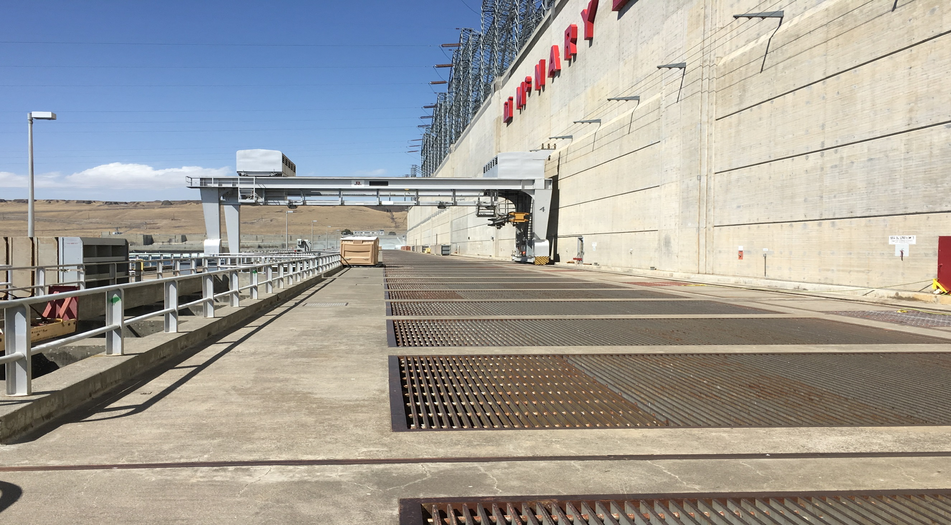
Tailrace Deck
Air line hatch door
air stones
North Bulkhead Slot
South Bulkhead Slot

Slide 5
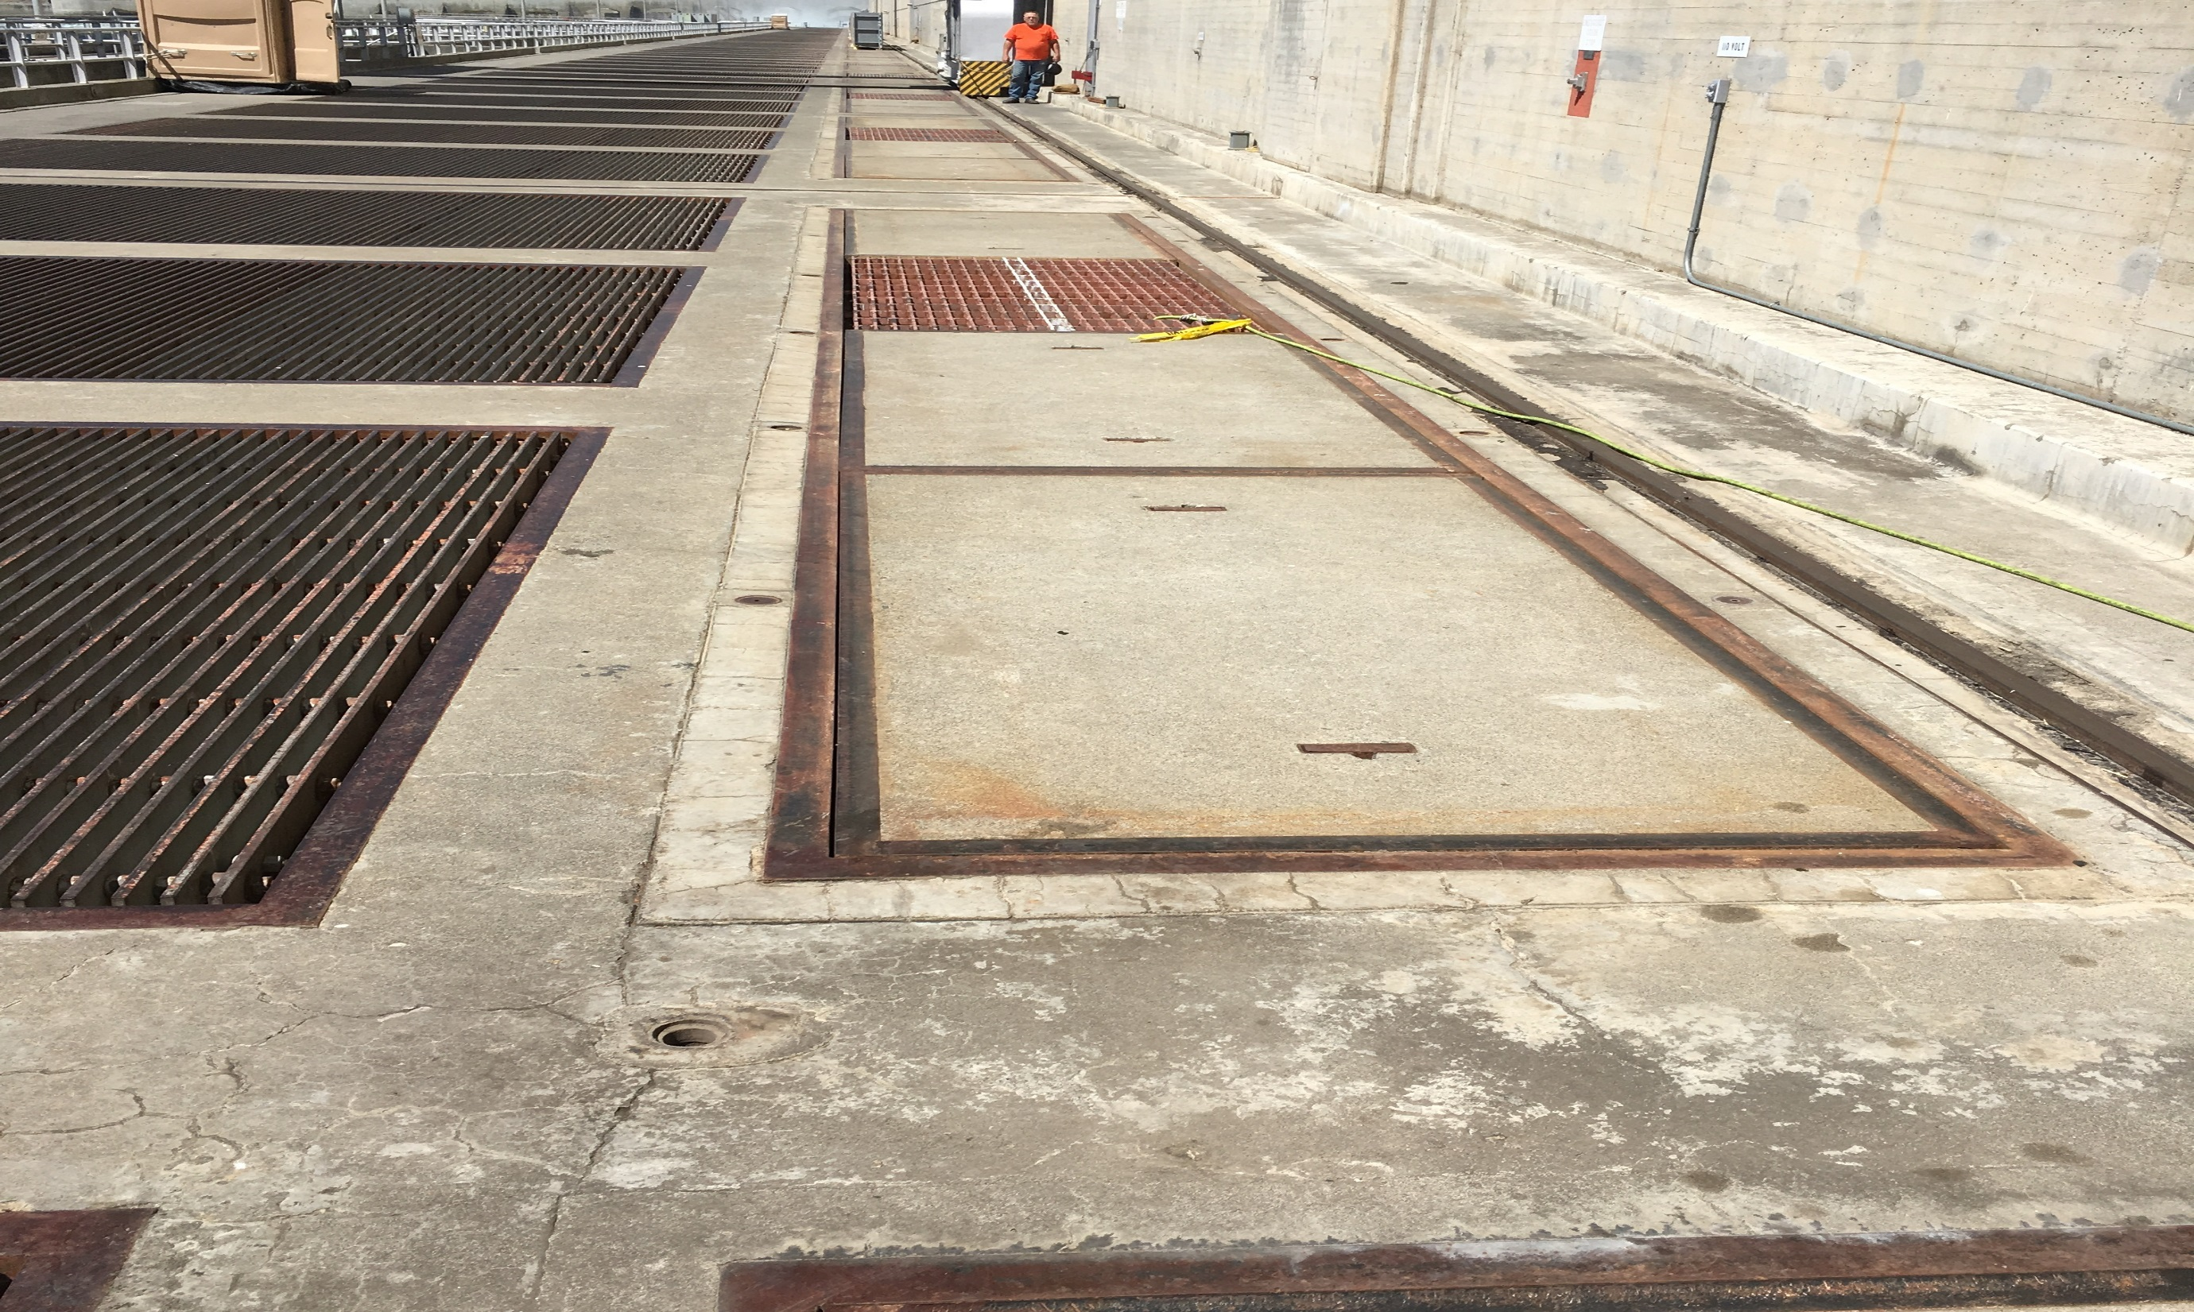
Fish were seen through grating
Concrete log covers are removed to salvage mortalities

Slide 6
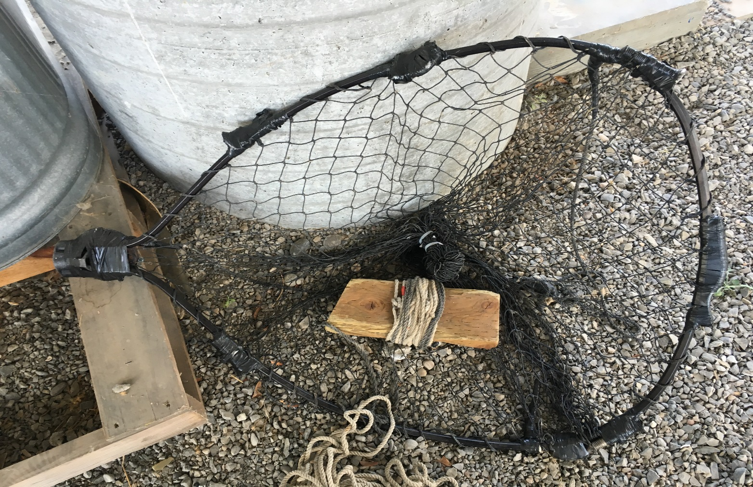
Net used to lower into slot
to retrieve fish mortalities

Slide 7
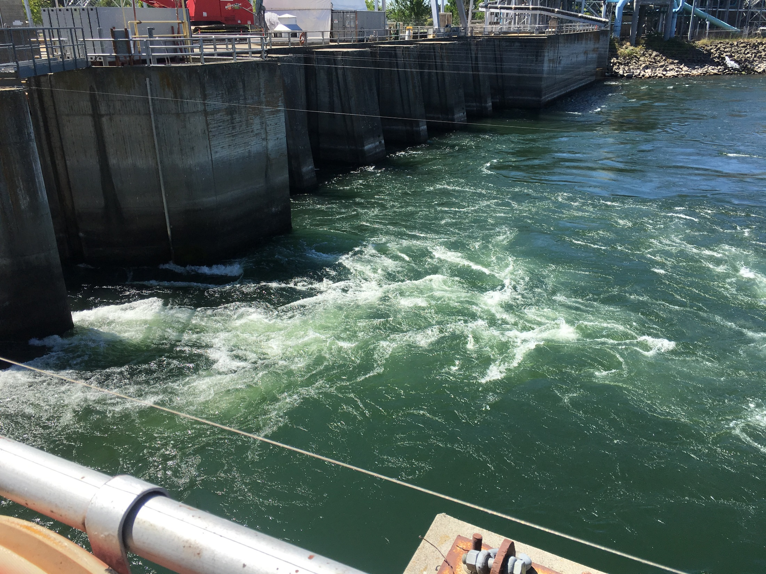
Oregon south ladder entrance
ladder flow
Unit 1 is near the south Oregon ladder powerhouse entrance.
Salmon may have false attraction to Unit 1.

Slide 8
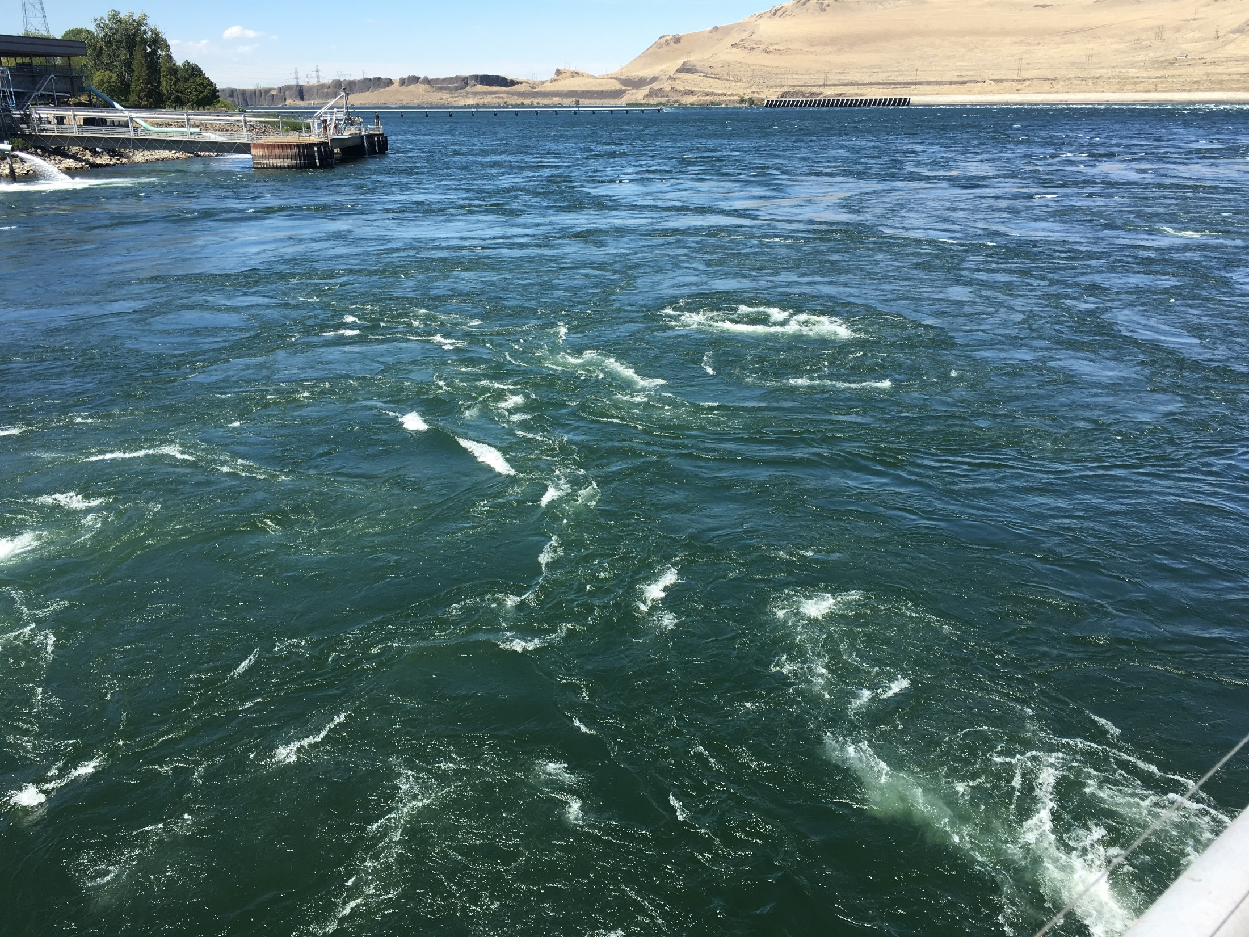
Unit 2
turbine
boil
Approximate Unit 1
Turbine boil
Ladder entrance flow
FOG flow

Slide 9
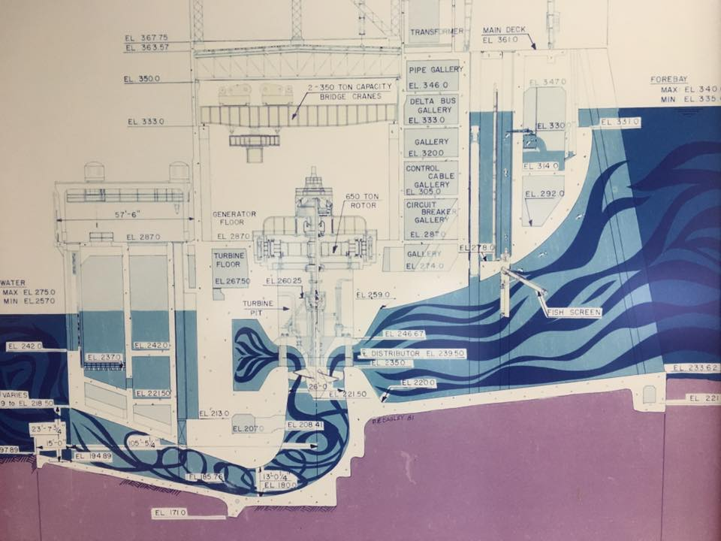
Recess
Transverse section

Slide 10
Larger Schematic
Recess

Slide 11
Tailrace Deck/opening
Recess

